Slide 1
LESSON 5.3
Separation Techniques

Slide 2
LESSON GOALS
I can explain and deduce a strategy to separate a mixture using the following techniques: solvation, filtration, recrystallization, evaporation, distillation and/or paper chromatography.
I can explain, calculate, and interpret the retardation factor (R_{f}) values for chromatography.

Slide 3
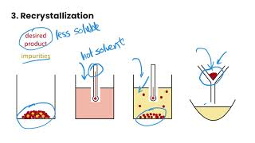
TASK 1: LEARN (MUST DO)
Individually or with a partner:
Watch the separation techniques video
Complete the guided note

Slide 4
TASK 2: GROUP PRACTICE (MUST DO)
In groups of 2-3:
Make a copy of the Separation Techniques group activity for your group and complete the activity
Submit your completed set of group slides by sharing them with me when you are done!

Slide 5
TASK 3: PRACTICE
Complete the separation techniques practice (answers included)
Note: There are must do, should do, and aspire to do questions included in this practice!

Slide 6
TASK 4: MASTERY CHECK (MUST DO)
Complete the separation techniques mastery check (posted in Brightspace under Quizzes!).

